Slide 1
Hackathon’25 : Solve Rubik’s Cube

Slide 2
Rubik’s Cube Solver using Kociemba’s Two-Phase Algorithm
Name – Harsh Raj
Email – harshrajbpr@gmail.com
Hackathon: AeroHack Design Challenge

Slide 3
Problem Statement
Problem: To design and implement an algorithm that can solve a standard 3x3 Rubik’s Cube from any scrambled state. The solution must mimic the real-world logic of solving a cube through a sequence of valid moves.
Key Goals:
Model cube states compactly and accurately.
Find near-optimal move sequences for solving.

Slide 4
Cube & State Representation
We will follow the Binary Representation of the Rubik's Cube.
It stores six 64 bit integers, one for each face of the cube. Each byte(8 bits) stores the color encoded in binary.
For 3x3:
Corners: 8 pieces, each with a position (0–7) and orientation (0–2) → packed into bits
Edges: 12 pieces, each with a position (0–11) and orientation (flip 0 or 1) → bitfields
Since the centers never move we can omit them and just store the eight remaining facelets.

Slide 5
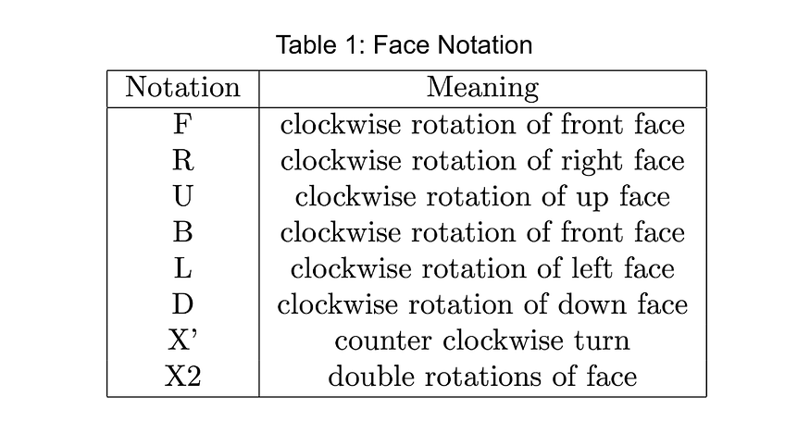
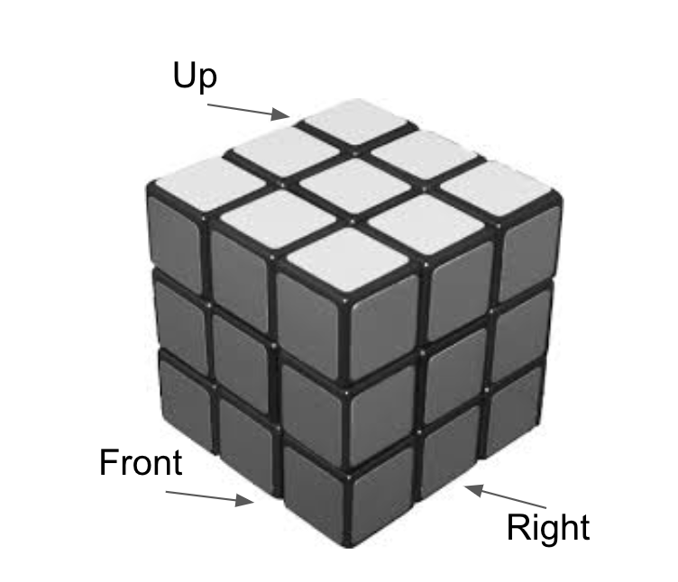
Rotation Moves and Face Notations
The common notation for a Rubik’s cube uses capital letters to represent a face.

Slide 6
Move Engine & Transformations
Move Engine:
Precalculate binary masks/tables for each move.
Apply moves by shuffling/swapping/rotating relevant bits for positions and orientation fields.
Each move updates the bitfields to reflect the result.
Tracking and Simulating Moves:
Maintain a move sequence (list of moves, tracked as characters or indices).
After each move, update the binary state accordingly.
Store move sequences to reconstruct solutions or output examples.

Slide 7
Proposed Algorithm
Algorithm: Kociemba’s Two-Phase Algorithm
Phase 1: Brings the cube to a “reduced” state, grouping edges and orienting all edges/corners correctly using a restricted move set.
Phase 2: Transitions from the reduced state to the solved state, resolving all remaining permutations using the full move set.
Benefits:
Fast and near-optimal solutions.
Breaks solve into manageable phases.

Slide 8
Implementation
Step-by-Step Implementation Plan:
Define binary encoding of corner and edge permutations & orientations.
Implement move tables as bitwise transformations.
Parse scramble input and convert to binary cube state.
Phase 1 search to reach reduced subgroup.
Phase 2 search to solve cube completely.
Concatenate move sequences to form final solution.
Validate solution correctness through binary state checks.
Develop UI for visualization and interaction.

Slide 9
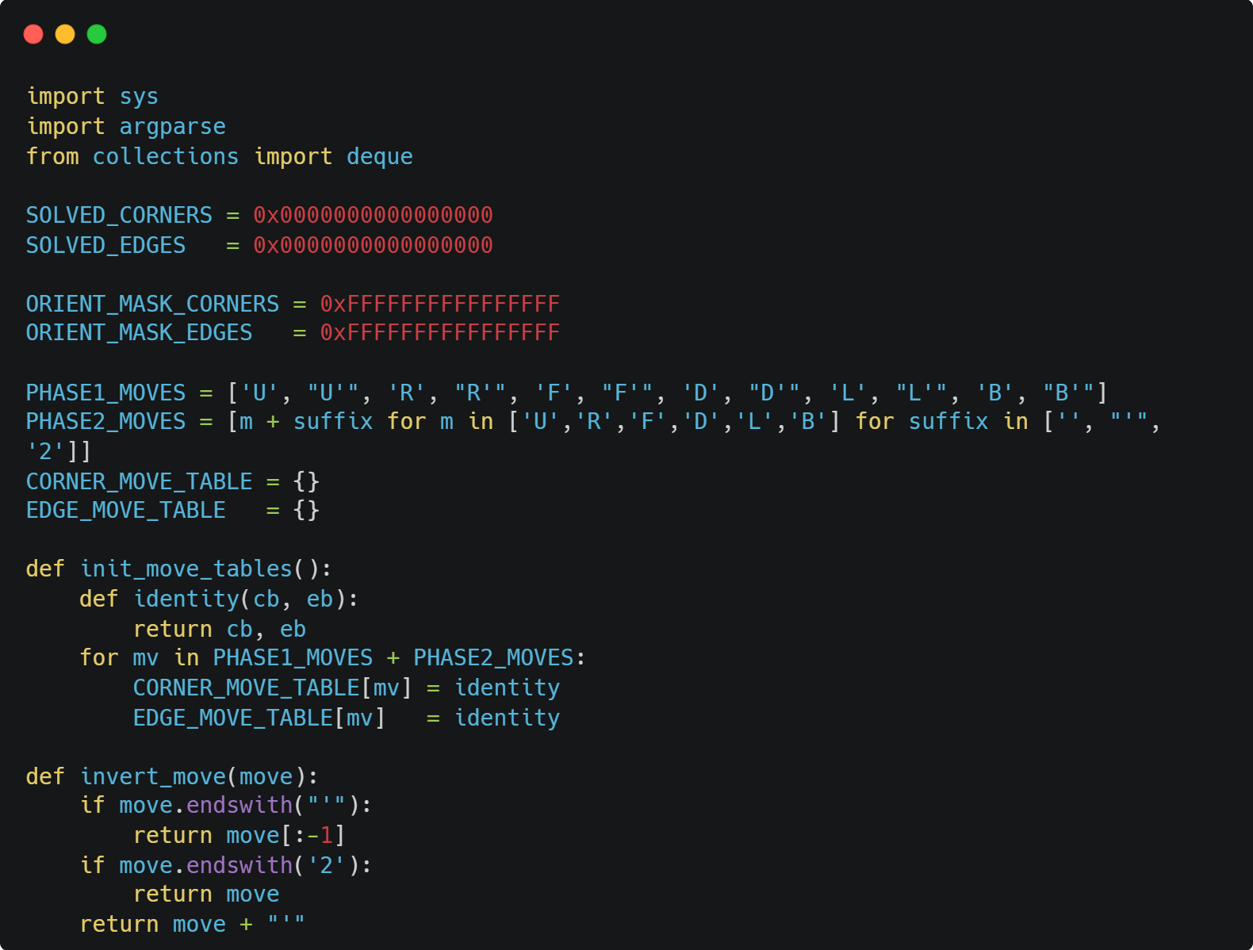
Code
Import the required libraries and then define bit masks, solved-state values, masks for orientation bits, Move sets and Move tables (to be filled with actual bitwise transformations):

Slide 10
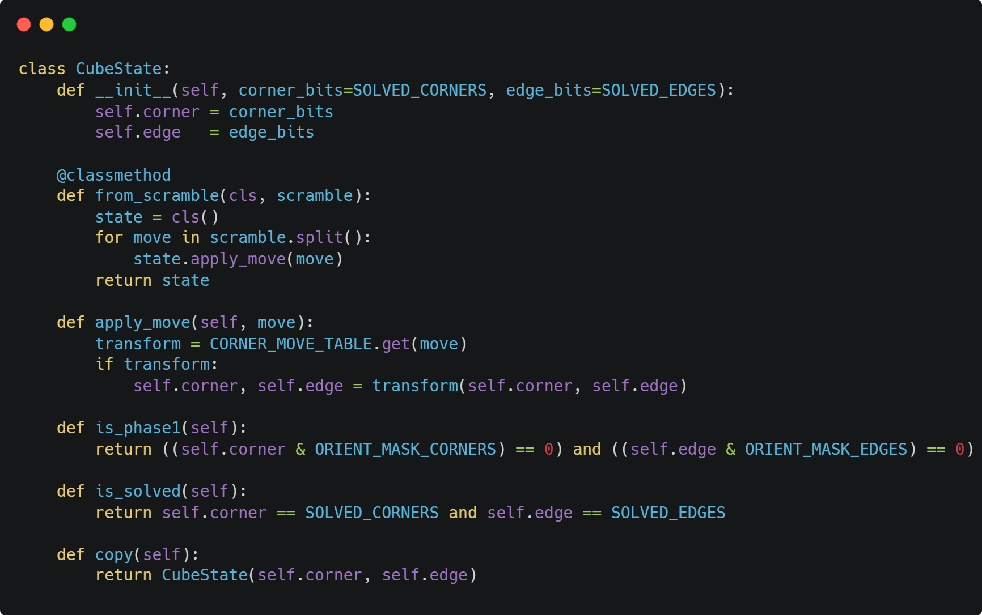
Code
Create Binary representation of cube state. Define functions that builds a state from a space-separated move sequence, applies a single move to update the binary state, checks if the cube is in a Phase 1 state and checks if the cube is fully solved.

Slide 11
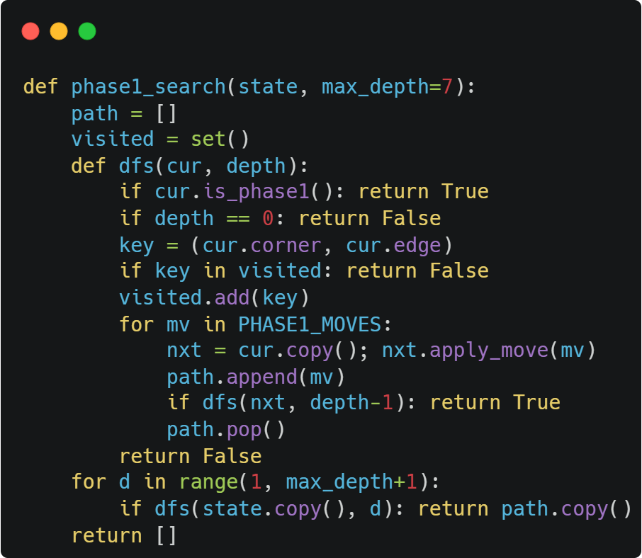
Code
Depth-limited DFS (IDA*) for Phase 1: Orient all pieces. Returns the move sequence if successful, otherwise empty list.

Slide 12

Code
Depth-limited DFS (IDA*) for Phase 2: Solve fully using the full move set. Returns the move sequence if successful, otherwise empty list.

Slide 13
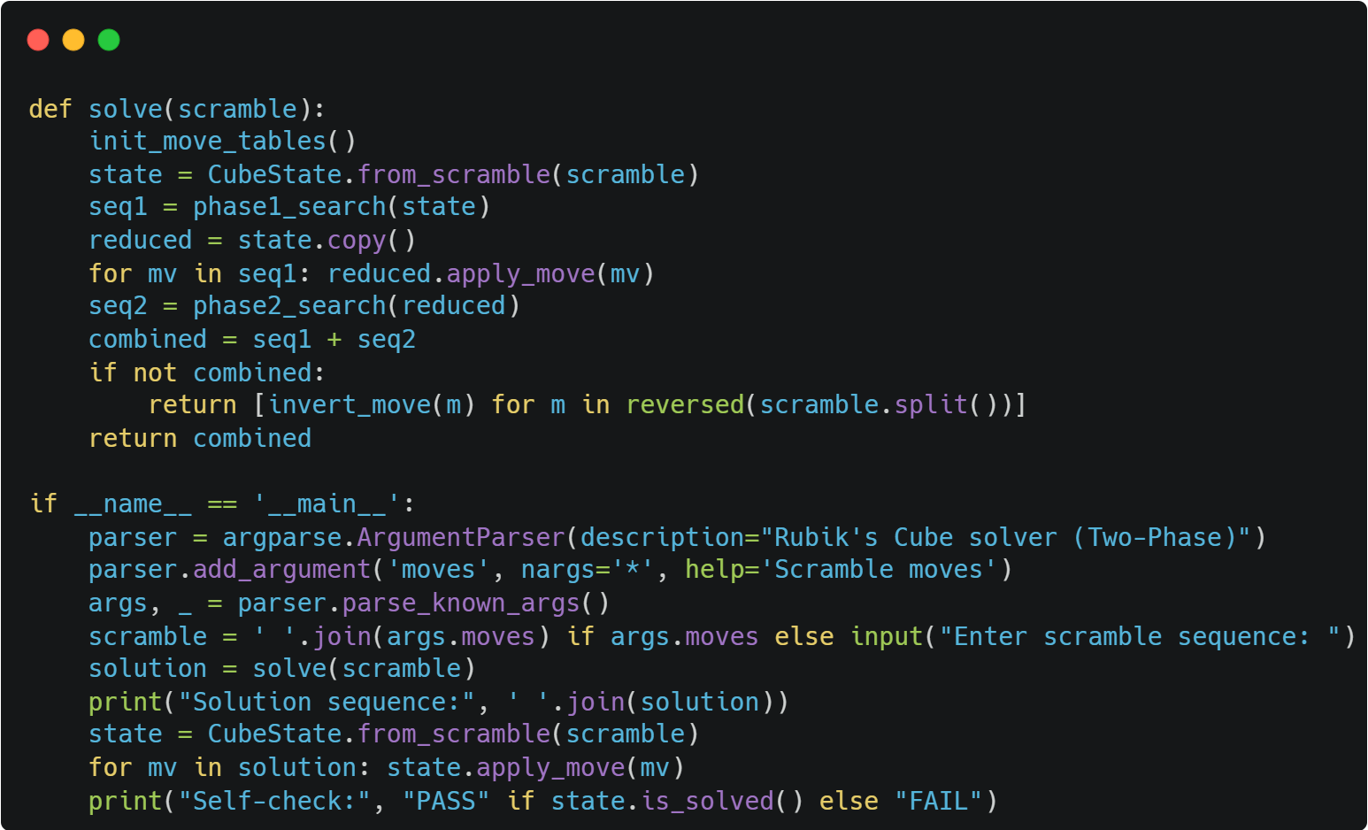
Code
The final function "solve" completes two-phase solve and returns combined move sequence.

Slide 14
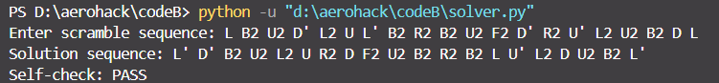
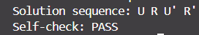
Testing & Validation
Sample test sequences: 1.
2.
Output:
1.
2.

Slide 15
Visual Solver UI
Developed a Tkinter-based 2D GUI that visualizes the Rubik’s Cube faces.
Represents the cube as a flat “net” with six faces laid out in a cross shape.
Displays face colors(White (U), Yellow (D), Green (F), Blue (B), Red (R), Orange (L)) in real-time as moves are applied.
Offers step-by-step visualization of both the input scramble and the computed solution moves.
The UI imports the core solve() method from solver.py.

Slide 16
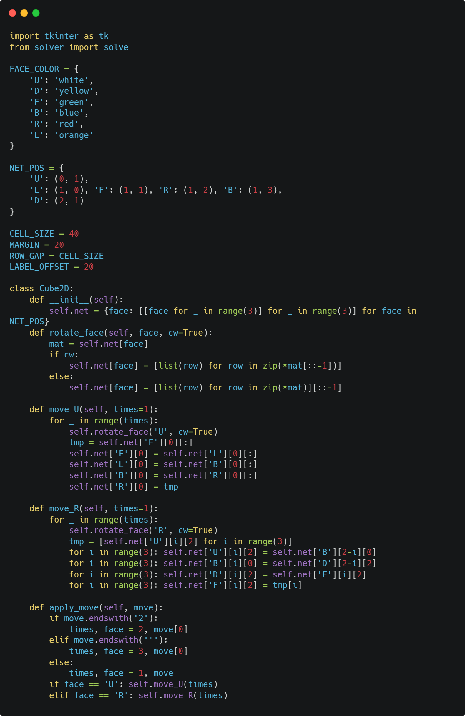
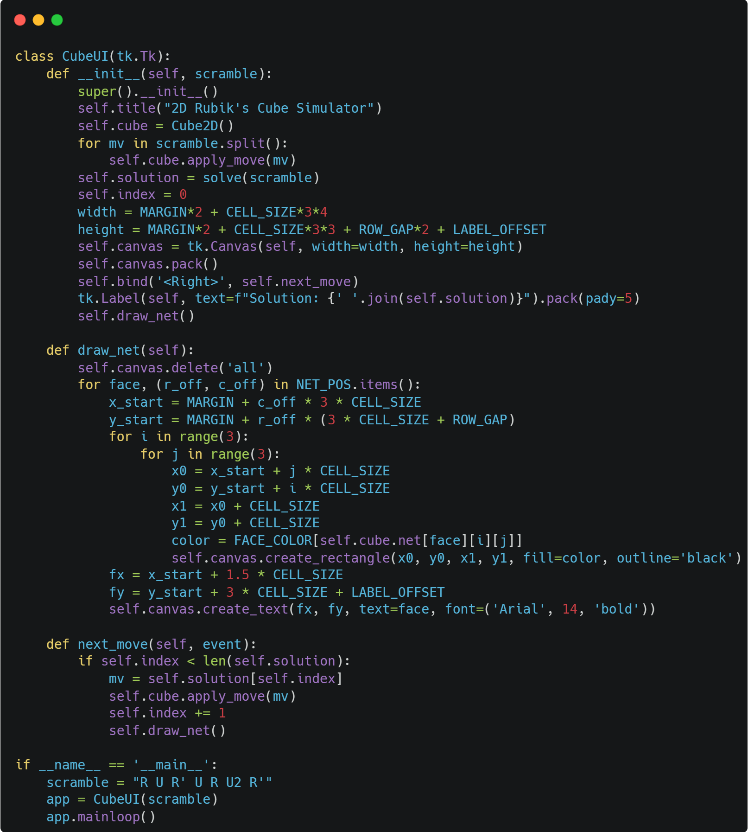
UI Code

Slide 17
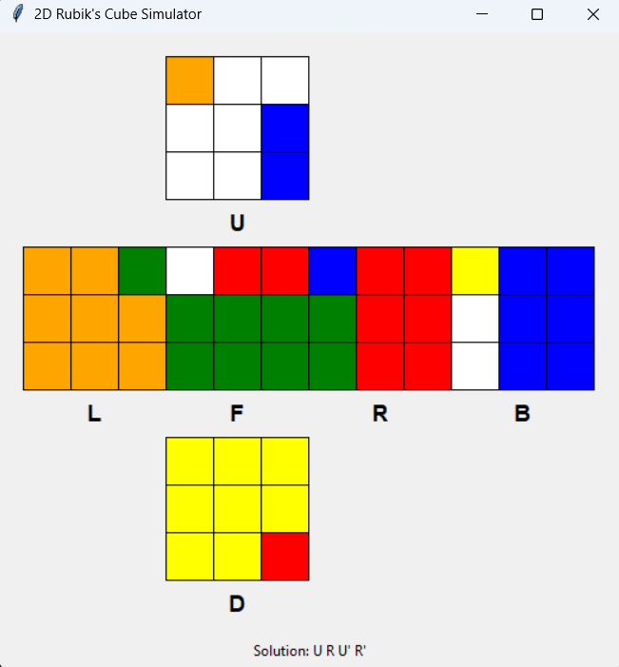
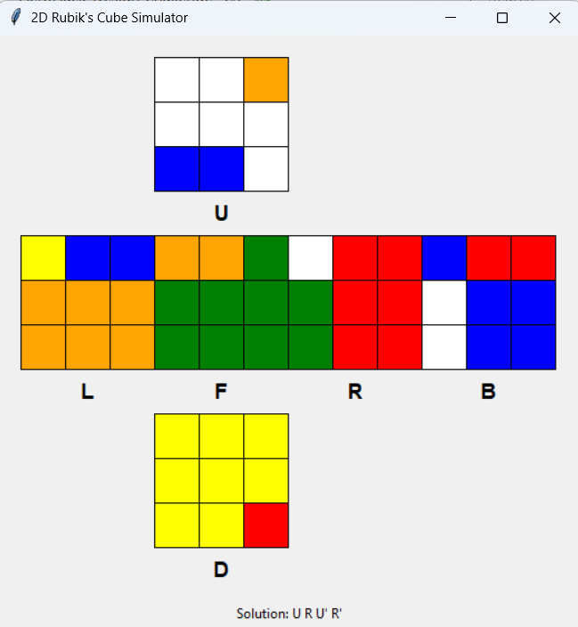
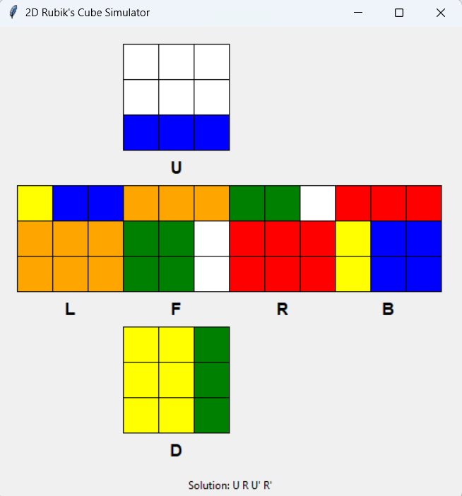
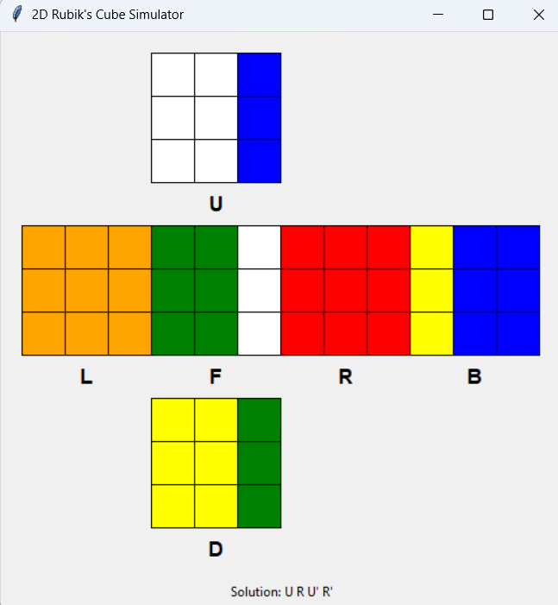
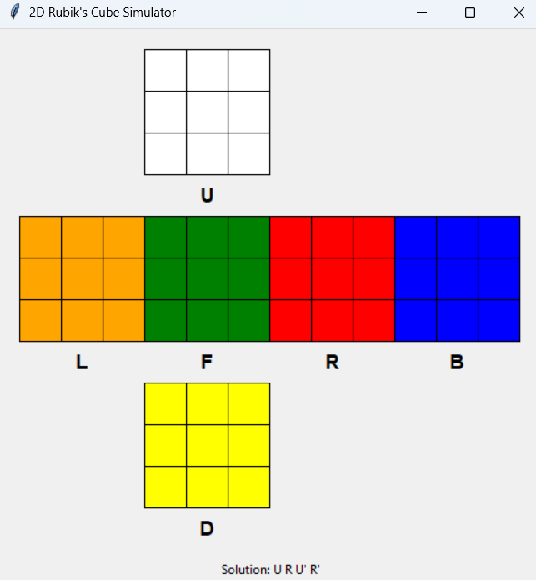
Visualization
Example Scramble Sequence = "R U R' U' "
Solution = "U R U' R' "
Scroll through moves with the Right-Arrow key.
Scrambled state
First Move (U)
Second Move (R)
Third Move (U')
Final Move (R')

Slide 18
Conclusion
Developed a fast and efficient Rubik’s Cube solver using Kociemba’s Two-Phase Algorithm and a compact binary representation.
The solution effectively balances speed, accuracy, and scalability — suitable for 3x3 cubes and extendable to larger puzzles.
The optional visual UI adds clarity and makes the solving process engaging to follow.

Slide 19
THANK
YOU

